Slide 1
Analysis of Autism Data Using Mixed Linear Effects Model Approach
By Aaron Niecestro

Slide 2
Autism Dataset Background
University of Michigan (Anderson et al. 2009) as part of a prospective longitudinal study
155 children enrolled in the study
Children either had Autism or Pervasive Developmental Disorder (PDD)
5 visits evaluated age 2, 3, 5, 9, and 13
Outcome = Vineland Socialization Age Equivalent (VSAE),
  social development score
Used Mixed Linear Effects model
  Data was missing at random
    Children either dropped out of study, were non-responsive for 1-3 visits, or had all 5 visits
Total Number of Visits | Number of Children | Percentage (%)
1 | 2 | 1.29
2 | 11 | 7.1
3 | 29 | 18.71
4 | 72 | 46.45
5 | 41 | 26.45

Slide 3
Research Questions
Do children with different language proficiency at age 2 have different levels of social development as they get older? If yes, is this statistically significant and if so, how well does this predict vsae?
Do children diagnosed with autism at age 2 have different levels of social development as they get older than children diagnosed with pdd at age 2? If yes, is this statistically significant and if so, how well does this predict vsae?
Do children whose race is categorized as white at age 2 have different levels of social development as they get older than children whose race is categorized as non-white at age 2? If yes, is this statistically significant and if so, how well does this predict vsae?
Is gender predictive of vsae? Do children who are male at age 2 have different levels of social development as they get older than children who are female at age 2? If yes, are they statistically significant and if so, how well does this predict vsae?
Are there other variables in this dataset predictive of vsae? If yes, are they statistically significant and if so, how well does this predict vsae?

Slide 4
Summary Statistics
Characteristic | Level | Age=2 | Age=3 | Age=5 | Age=9 | Age=13
 |  | n (%) | n (%) | n (%) | n (%) | n (%)
Diagnosis | Autism | 100 (64.94) | 95 (65.07) | 55 (60.44) | 76 (63.87) | 63 (67.02)
 | PDD | 54 (35.06) | 51 (34.93) | 36 (39.56) | 43 (36.13) | 31 (32.98)
Race | Non-White | 54 (35.06) | 52 (35.62) | 43 (47.25) | 35 (29.41) | 20 (21.28)
 | White | 100 (64.94) | 94 (64.38) | 48 (52.75) | 84 (70.59) | 74 (78.72)
Gender | Female | 20 (12.99) | 21 (14.38) | 12 (13.19) | 14 (11.76) | 11 (11.7)
 | Male | 134 (87.01) | 125 (85.62) | 79 (86.81) | 105 (88.24) | 83 (88.3)
Language | Low | 49 (31.82) | 46 (31.51) | 29 (31.87) | 36 (30.25) | 28 (29.79)
 | Medium | 65 (42.21) | 62 (42.47) | 36 (39.56) | 48 (40.34) | 40 (24.55)
 | High | 40 (25.97) | 38 (26.02) | 26 (28.57) | 35 (29.41) | 26 (27.66)

Slide 5
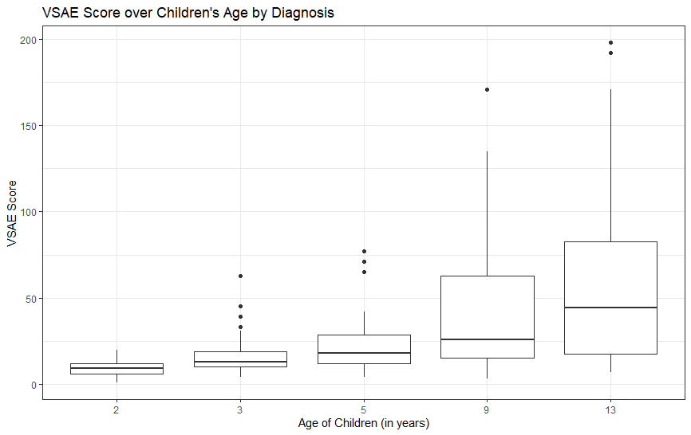
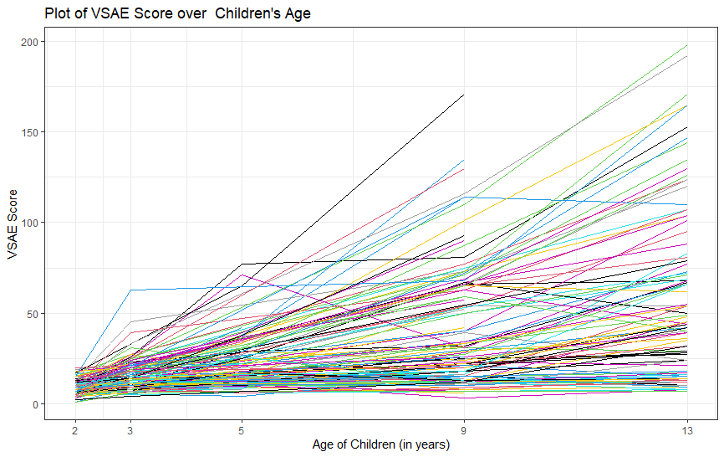
Summary Visualizations

Slide 6
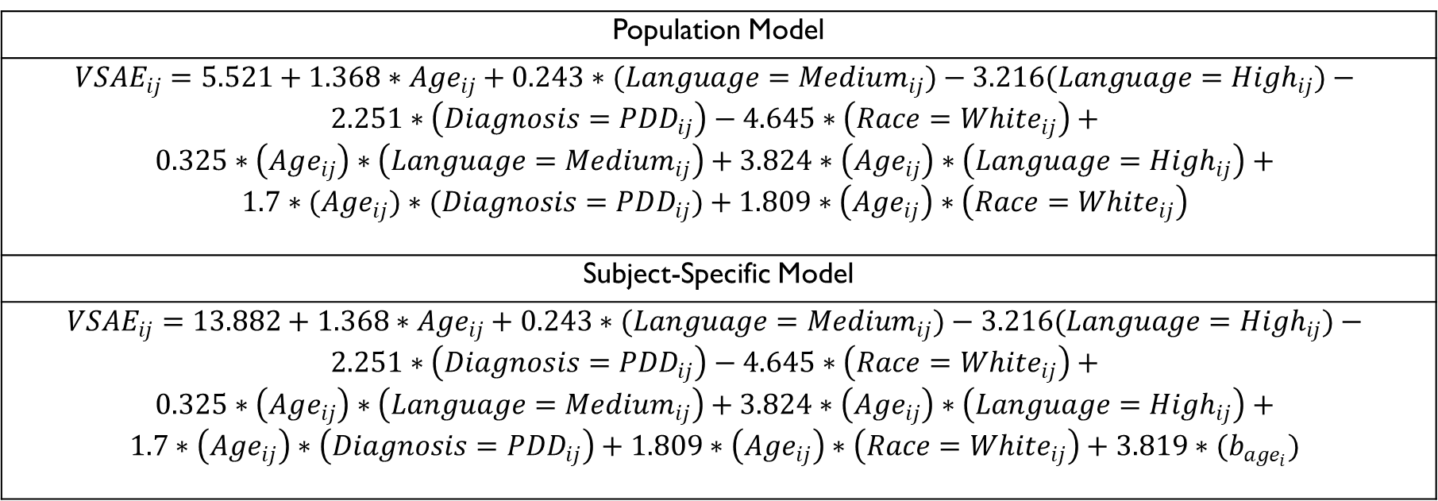
Final Model
Population Model
$$VSAE_{ij}=5.521+1.368∗Age_{ij}+0.243∗(Language=Medium_{ij})−3.216(Language={High}_{ij})−$$ $$2.251∗\left(Diagnosis=PDD_{ij}\right)−4.645∗\left(Race=White_{ij}\right)+$$ $$0.325∗\left(Age_{ij}\right)∗\left(Language=Medium_{ij}\right)+3.824∗\left(Age_{ij}\right)∗\left(Language=High_{ij}\right)+$$ $$1.7∗(Age_{ij})∗(Diagnosis=PDD_{ij})+1.809∗\left(Age_{ij}\right)∗\left(Race=White_{ij}\right)$$
Subject-Specific Model
$$VSAE_{ij}=13.882+1.368∗Age_{ij}+0.243∗(Language=Medium_{ij})−3.216(Language={High}_{ij})−$$ $$2.251∗\left(Diagnosis=PDD_{ij}\right)−4.645∗\left(Race=White_{ij}\right)+$$ $$0.325∗\left(Age_{ij}\right)∗\left(Language=Medium_{ij}\right)+3.824∗\left(Age_{ij}\right)∗\left(Language=High_{ij}\right)+$$ $$1.7∗\left(Age_{ij}\right)∗\left(Diagnosis=PDD_{ij}\right)+1.809∗\left(Age_{ij}\right)∗\left(Race=White_{ij}\right)+{3.819∗(b}_{age_{i}})$$

Slide 7

Thank You for listening

